Slide 1

And now selenium’s watch is ended
Using Cypress to write UI tests that are less brittle and run faster
Matthew Knowles
Software Craftsman at Greater Sum
www.GreaterSum.com
@MatthewYKnowles
Matthew@GreaterSum.com

Slide 2
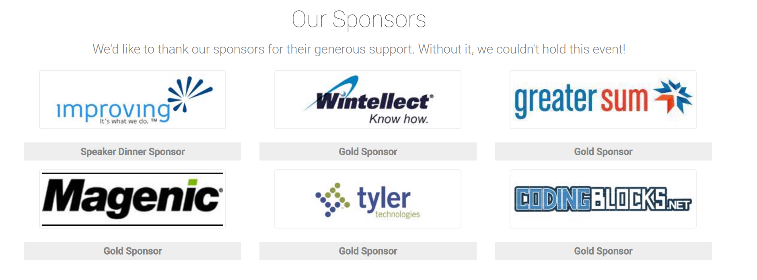
Atlanta Code Camp 2019

Slide 3
What we will talk about
Tests
Testing with Selenium
Testing with Cypress
Live coding Cypress tests
Advanced UI testing techniques
Notes:
Goal of the talk is to breakdown any friction from preventing you from going out and writing some tests against your professional project or even personal projects

Slide 4
Why do you write tests?

Slide 5
Why Write Tests?
Verify functionality
Defend against unexpected change
Executable documentation of the code

Slide 6
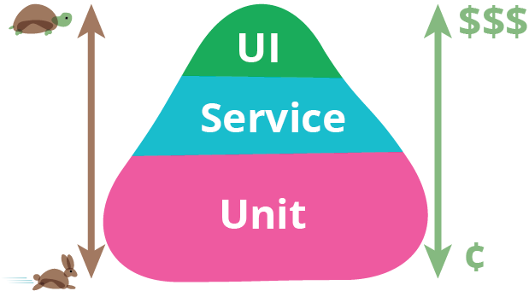
https://martinfowler.com/bliki/TestPyramid.html

Slide 7
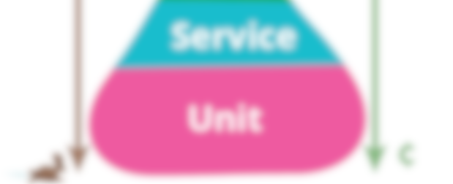
https://martinfowler.com/bliki/TestPyramid.html

Slide 8
Why Write UI/E2E Tests
Verify that the critical path works
Exercise your code in a live or live like environment
Notes:
Does it integrate? Are environment variables set correctly? Am I connected to correct database?

Slide 9
Why Write UI/E2E Tests
Human Readable
Behavior Driven Development (Dev/Product/Test)
Executable specification
Notes:
Behavior Driven Development is a methodology that encapsulates a lot but one of the core tenants is having a representative from product, dev, and test get together and come up with acceptance tests that flush out a feature. Today we are going to start writing our app with a failing acceptance test that when passing signifies that we have implemented the functionality that the product owner requested.

Slide 10
Why Write UI/E2E Tests
Legacy code
Notes:
Mike says Bridge!!!

Slide 11
Selenium to Cypress in a project

Slide 12
Flaky tests

Slide 13
Debugging
Notes:
Finding out why a test failed is a lot easier (pictures, videos, DOM snapshot)

Slide 14
Failures in build pipeline
Notes:
Much easier to diagnose failures in CI

Slide 15
Test writing
Notes:
Writing new tests did not take as long

Slide 16
Time to execute
18 -> 10 minutes

Slide 17
Access outside browser
Notes:
Could no longer use port to verify information sent over email
File system issues

Slide 18
Intro to Cypress
Notes:
Testing framework for web applications
It is already in the browser. It knows whats going on in your application in browser. Can wait for async requests to resolve. As opposed to using a wait.

Slide 19
Why not to use Cypress
Firefox, Safari, and Edge
Access outside the browser
Has been out of beta less than 1 year
Notes:
Selenium is more like a real user of the product.

Slide 20
Cypress Demo
Atlanta Code Camp 2019 Website

Slide 21
Cypress Demo
Connect Four

Slide 22
HTML Data Attribute

Slide 23
Cypress Demo
Connect Four with data attributes

Slide 24
Page Object Pattern

Slide 25
Cypress Demo
Connect Four with page objects

Slide 26
Image Comparison

Slide 27
Cypress Demo
Connect Four with image comparison

Slide 28
Whatever you would manually test try and automate
Notes:
Where you can start.
How will we know what we’ve made changes correctly?
How will we know that we haven’t broken anything?

Slide 29
https://martinfowler.com/bliki/TestPyramid.html
Notes:
We only had a chance to talk about the top

Slide 30
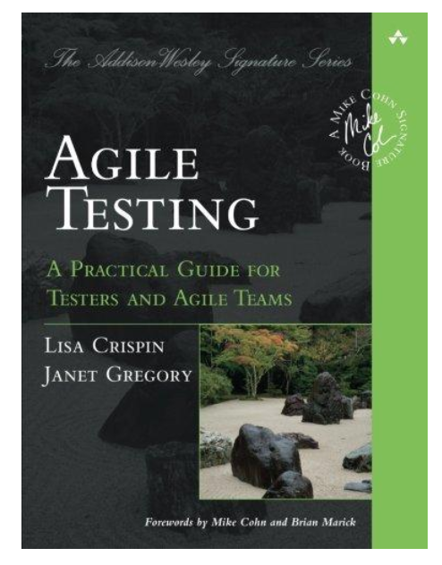
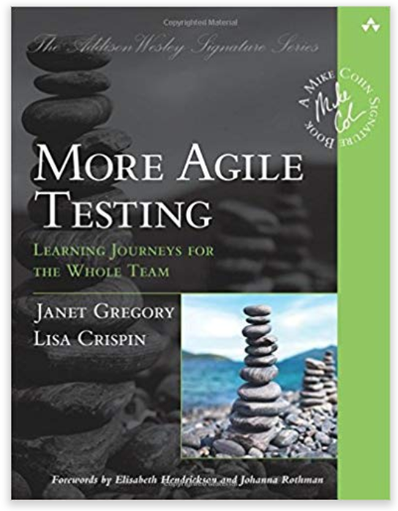
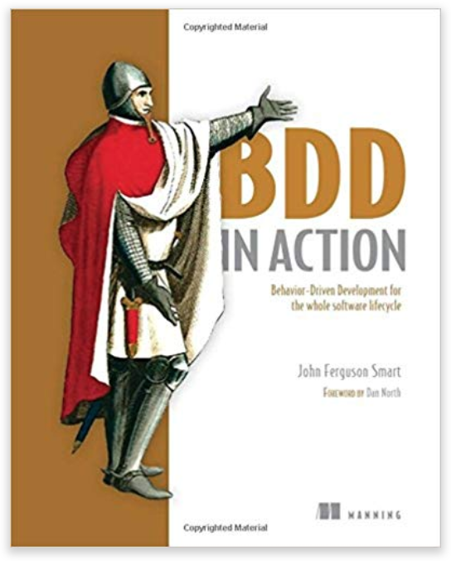
Resources
Notes:
We only had a chance to talk about the top

Slide 31
Questions?
@MatthewYKnowles
Matthew@GreaterSum.com

